Slide 1
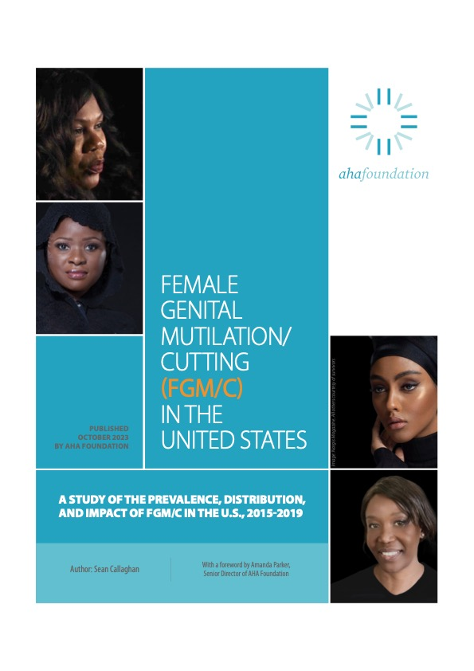


Slide 2

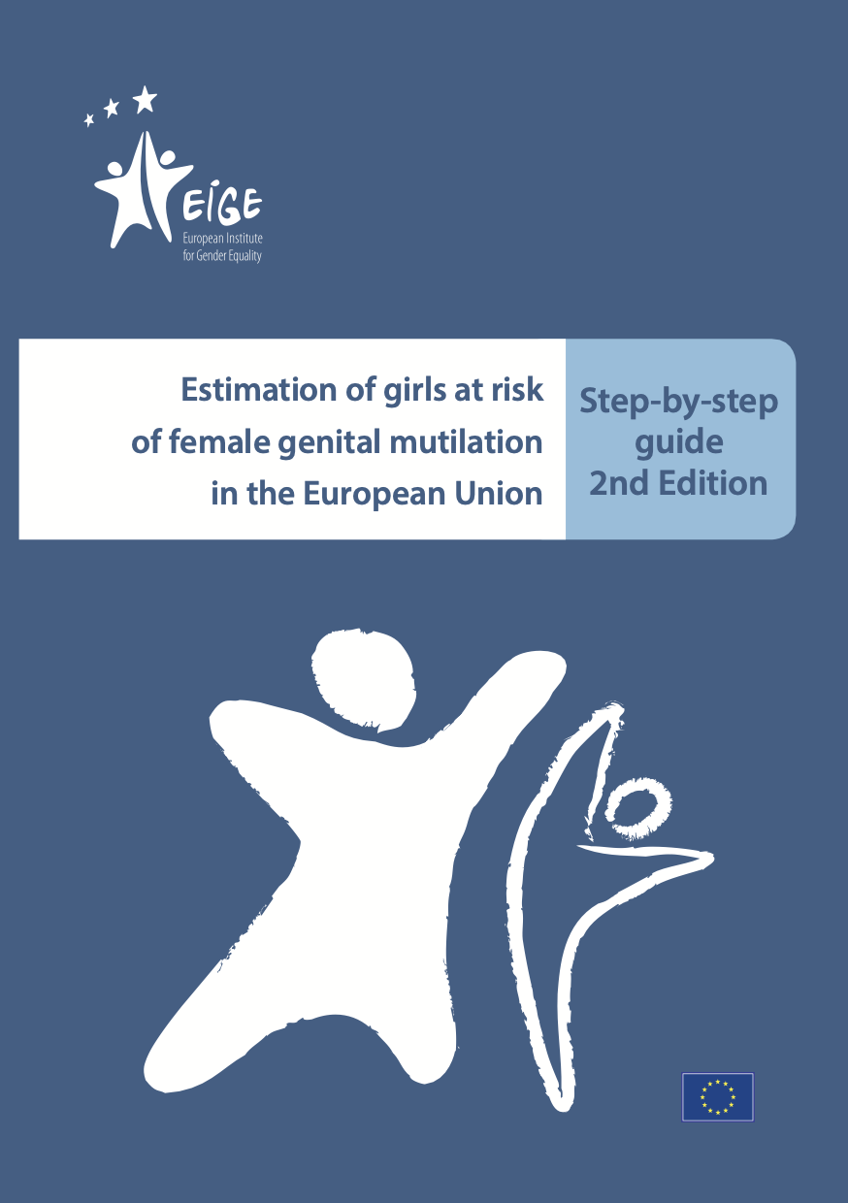
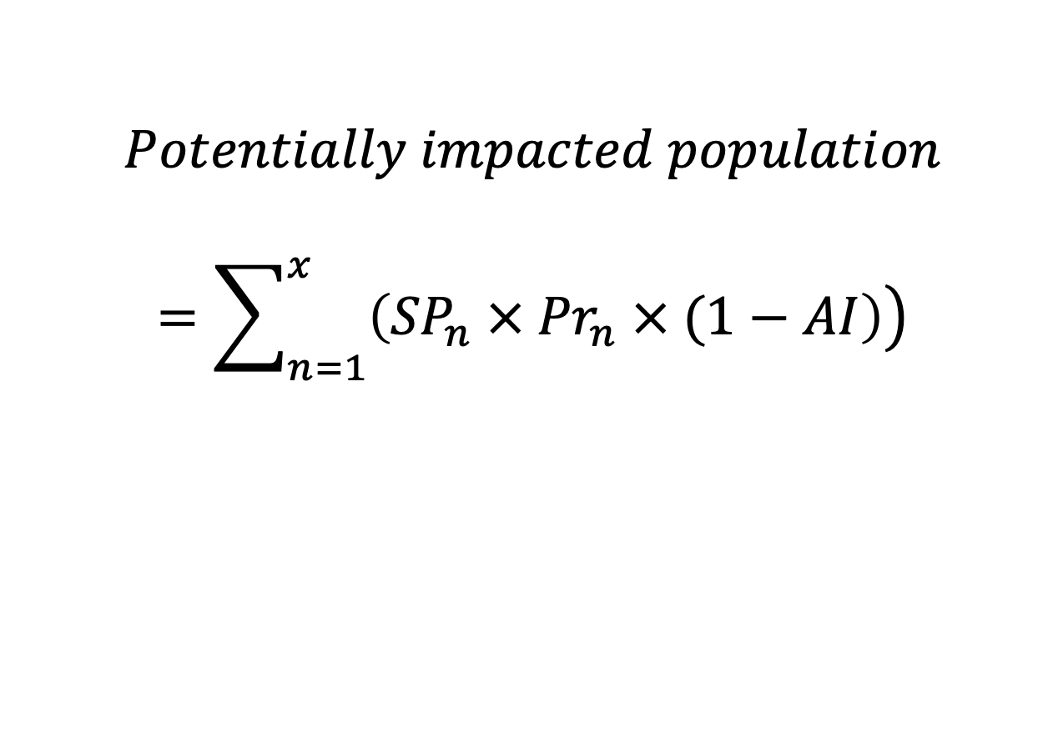
Sean Callaghan, 2024
Sean Callaghan, 2022
The Extrapolation-of-FGM/C-Countries’-Prevalence-Data
$$Potentially impacted population$$
$$=\sum_{n=1}^{x}{\left.\left({SP}_{n} × {Pr}_{n} × (1−AI\right)\right)}$$
Initial Estimate
Scenario-based
EIGE, 2018
Notes:
De Schrijver et al., 2020
Yoder and Van Baelen

Slide 3
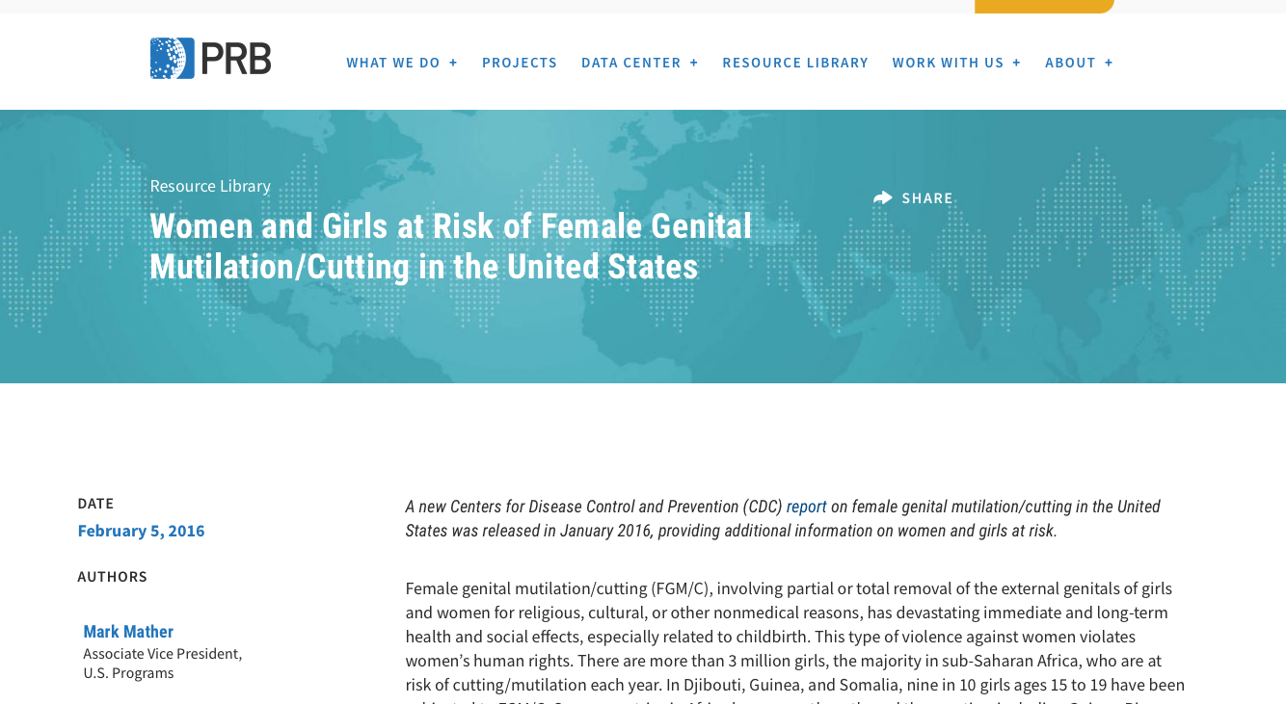
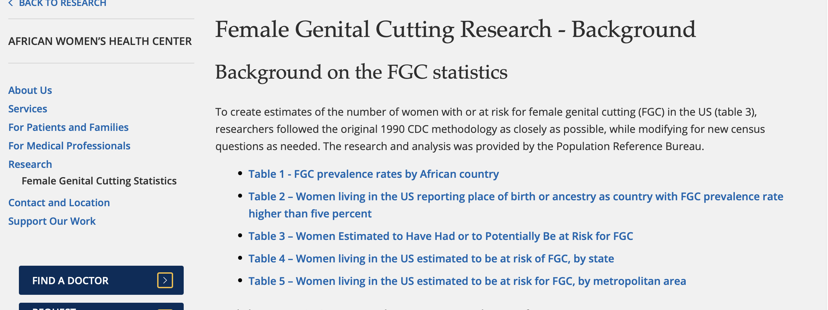
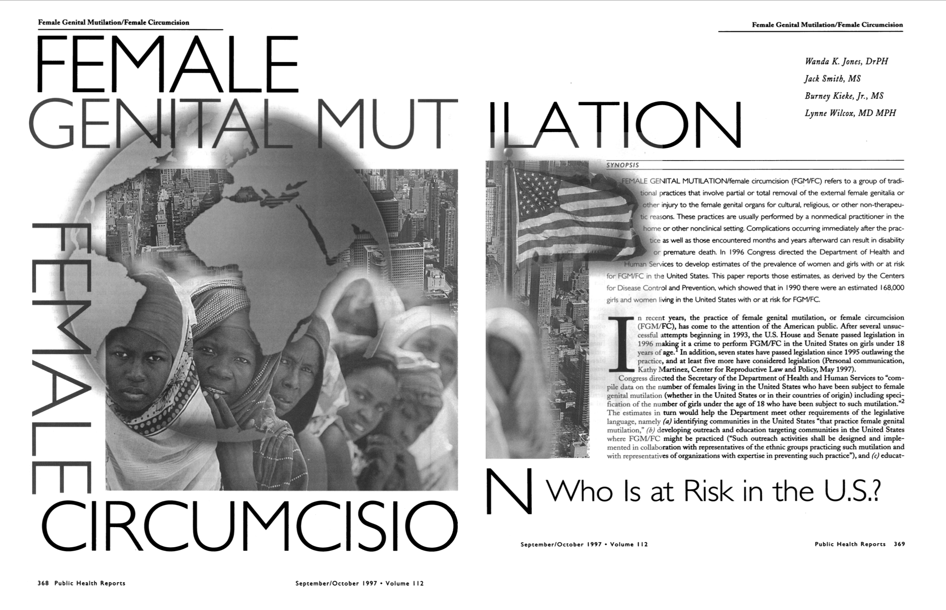
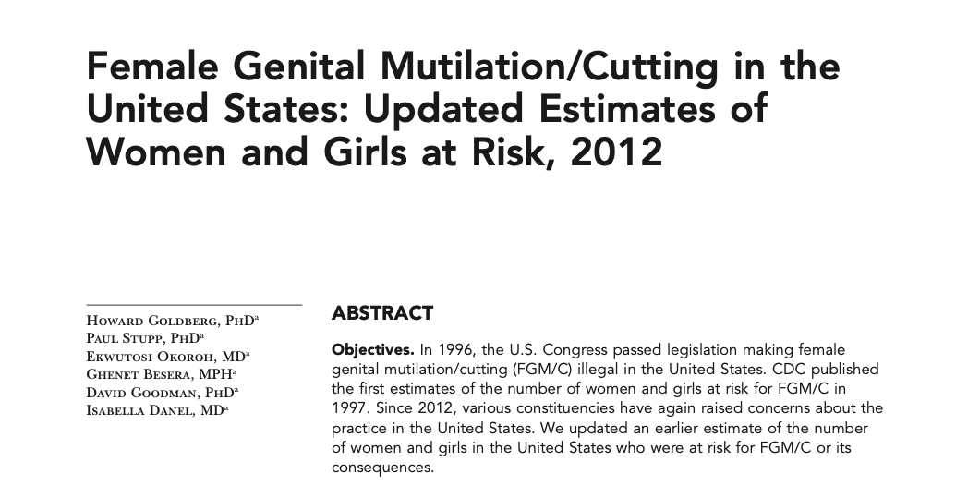
Sean Callaghan, 2024
Sean Callaghan, 2022
227,887 impacted
506,795 impacted
Mather & Feldman-Jacobs, 2016 (2013 data)
African Women’s Health Center, 2004 (2000 data)
Previous US studies
1990
2012
2000
Jones et.al, 1996 (1990 data)
Goldberg et.al, 2016 (2012 data)
168,000 impacted
513,000 impacted

Slide 4
Addressing the limitations related to the population data
Sean Callaghan, 2024
Sean Callaghan, 2022
Limiting the countries-of-origin considered relevant;
An over reliance on country of birth as the primary indicator of risk;

Slide 5
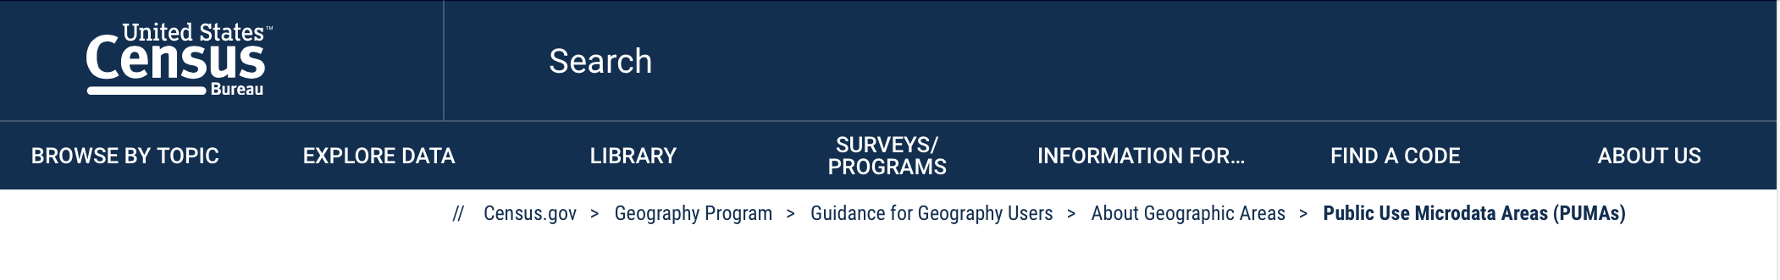
Sean Callaghan, 2024
Sean Callaghan, 2022
American Community Survey
ACS 2015-2019
(5% nationally representative weighted sample)

Slide 6
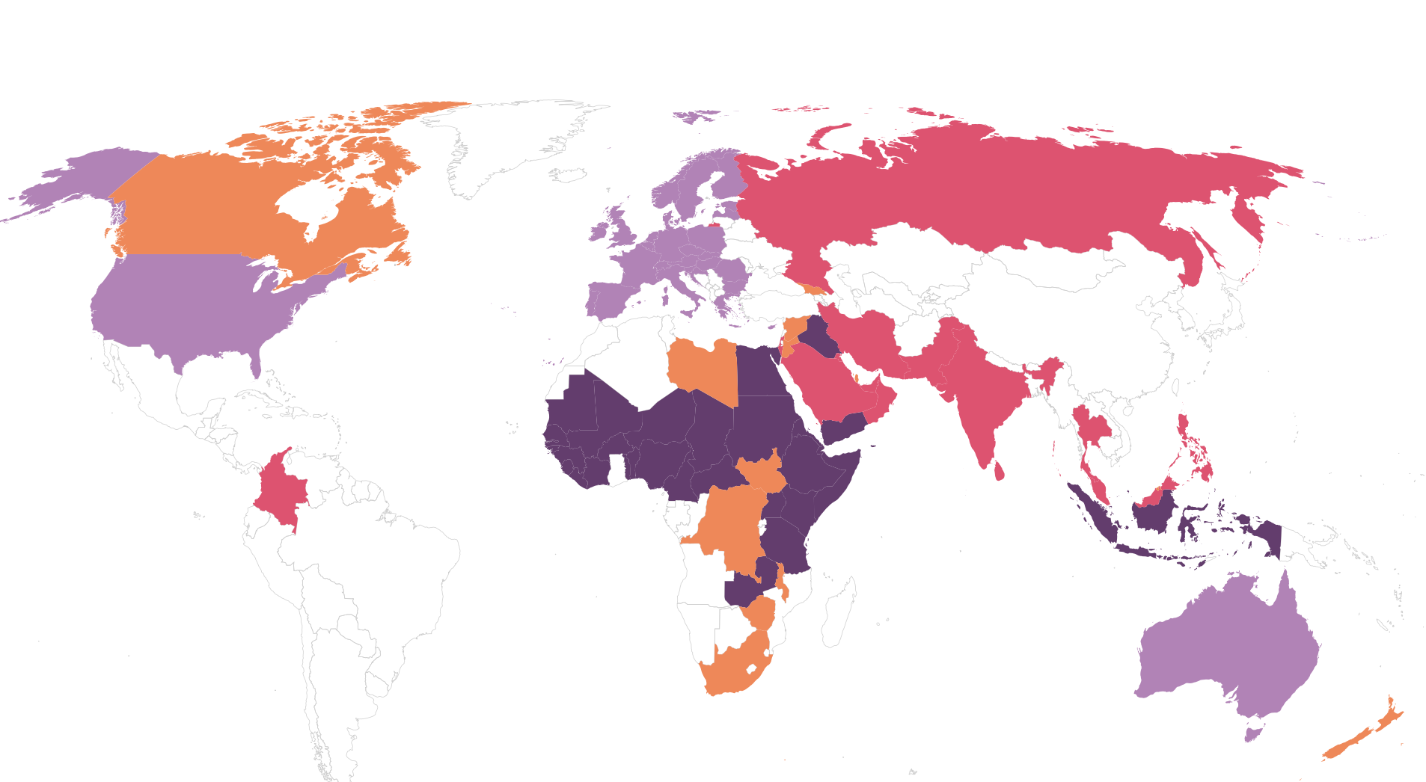
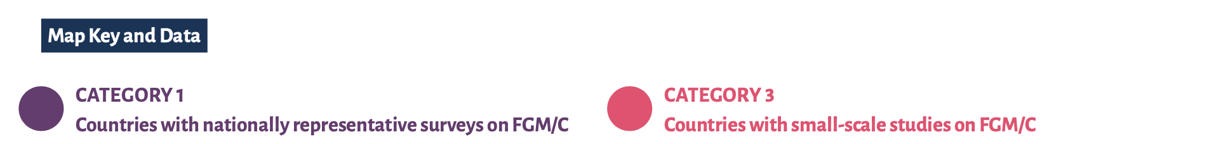


Sean Callaghan, 2024
Increase the countries of origin included
National representative surveys (n=32)
Small-scale studies (n=15)
Indirect estimates (n=31)
Anecdotal evidence (n=15)
Equality Now, 2020
Addressing Limitation 1 – countries in scope
Notes:
Limiting the countries-of-origin considered relevant

Slide 7
Sean Callaghan, 2024
Sean Callaghan, 2022
Somali community
Addressing Limitation 2 – ethnicity v country of birth
Somalia (99.2%)
Eastern Ethiopia (98.5%)
Northeastern Kenya (97.5%)

Slide 8
Sean Callaghan, 2024
Place of birth for Somali community resident in the USA
Addressing Limitation 2 – ethnicity v country of birth
Somalia
Minnesota
Washington
Kenya
Ethiopia
Native born
Foreign born

Slide 9
Addressing the limitations related to the prevalence rates
Sean Callaghan, 2024
Sean Callaghan, 2022
Failure to desegregate the prevalence data by age;
Reliance on latest prevalence survey data only, thus;
Failure to consider variations within a country’s prevalence data;
Failure to take age of cutting into account;

Slide 10
Sean Callaghan, 2024
Sean Callaghan, 2021
Prevalence in Ethiopia
Addressing Limitation 3 & 4 – desegregate by age based on all available surveys

Slide 11
Sean Callaghan, 2024
Sean Callaghan, 2021
Prevalence in Ethiopia
Addressing Limitation 3 & 4 – desegregate by age based on all available surveys
Age-specific mean
Addressing Limitation 3 & 4 – desegregate by age based on all available surveys

Slide 12
Sean Callaghan, 2024
Sean Callaghan, 2021
Sean Callaghan, 2023
Prevalence in Ethiopia
Addressing Limitation 3 & 4 – desegregate by age based on all available surveys
Age-specific mean
National Average

Slide 13

Sean Callaghan, 2024
Sean Callaghan, 2021
Prevalence in Ethiopia
Addressing Limitation 3 & 4 – desegregate by age based on all available surveys
Age-specific Mean
National Average
Previous studies over-estimated children at risk and under-estimated adults living with FGM/C

Slide 14
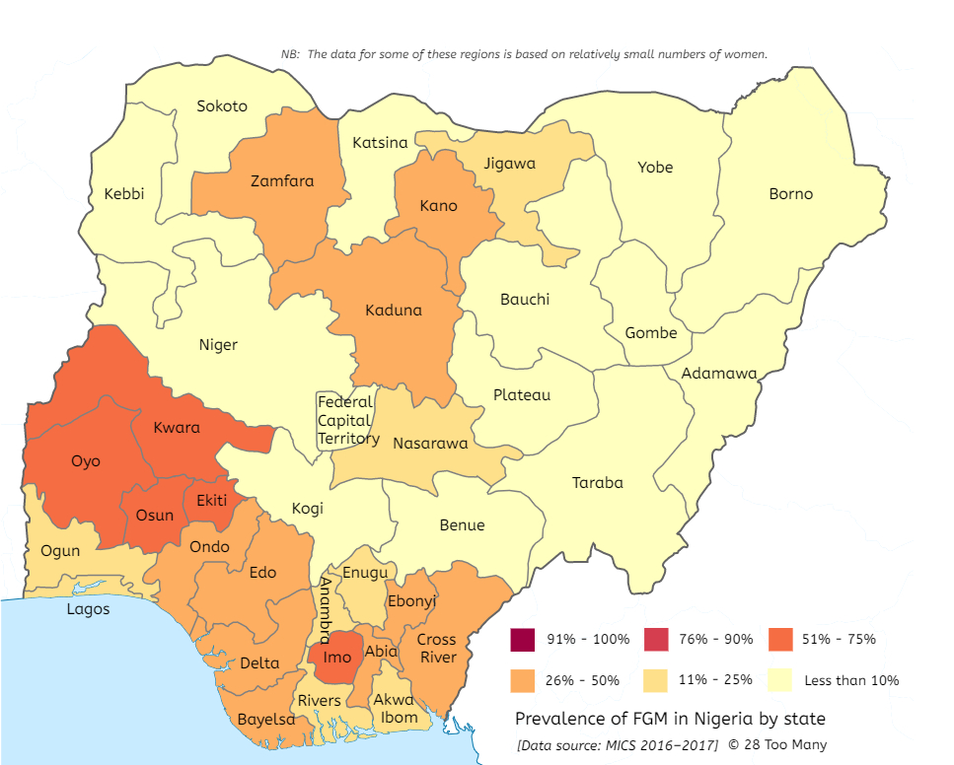
Variations within a country
Sean Callaghan, 2024
Sean Callaghan, 2022
Addressing Limitation 5 – in country variations
Less about regions and more about ethnicity
Migrant population data often does not allow us to segment at this level
Notes:
Failure to consider variations within a country’s prevalence data;
Unable to segment at this level in the population data

Slide 15
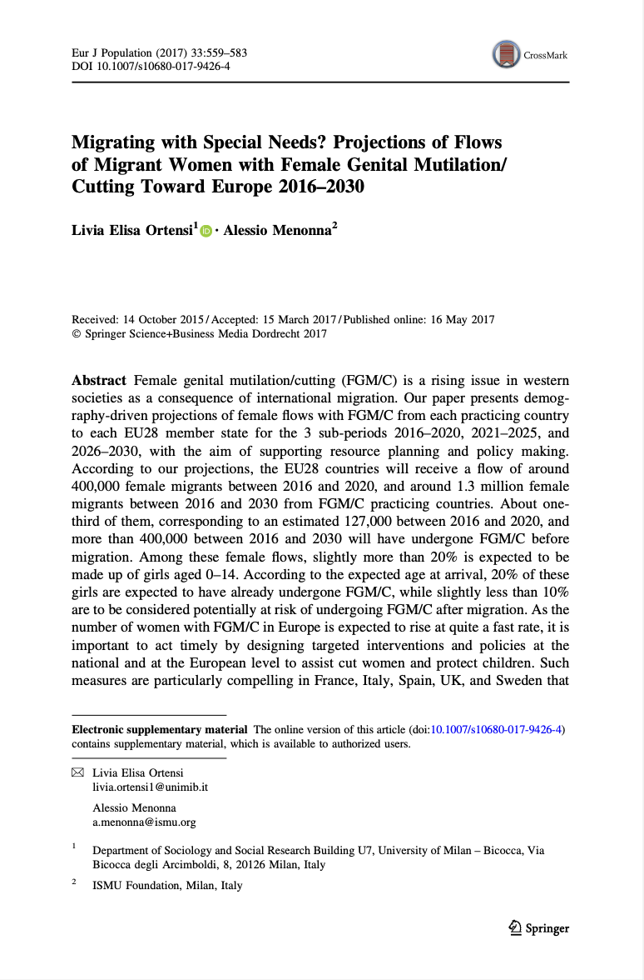
Selection Hypothesis
Sean Callaghan, 2024
Sean Callaghan, 2022
Addressing Limitation 5 – in country variations
Those most likely to migrate to the United States are urban, richer and more educated
Notes:
Failure to consider variations within a country’s prevalence data;
Ortensi proposes a solution that gets us some way towards a better estimate

Slide 16
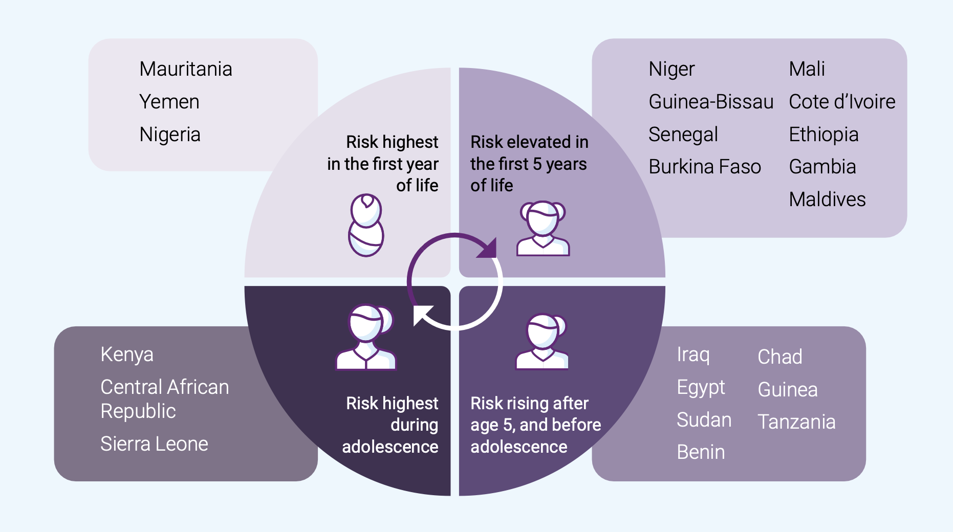
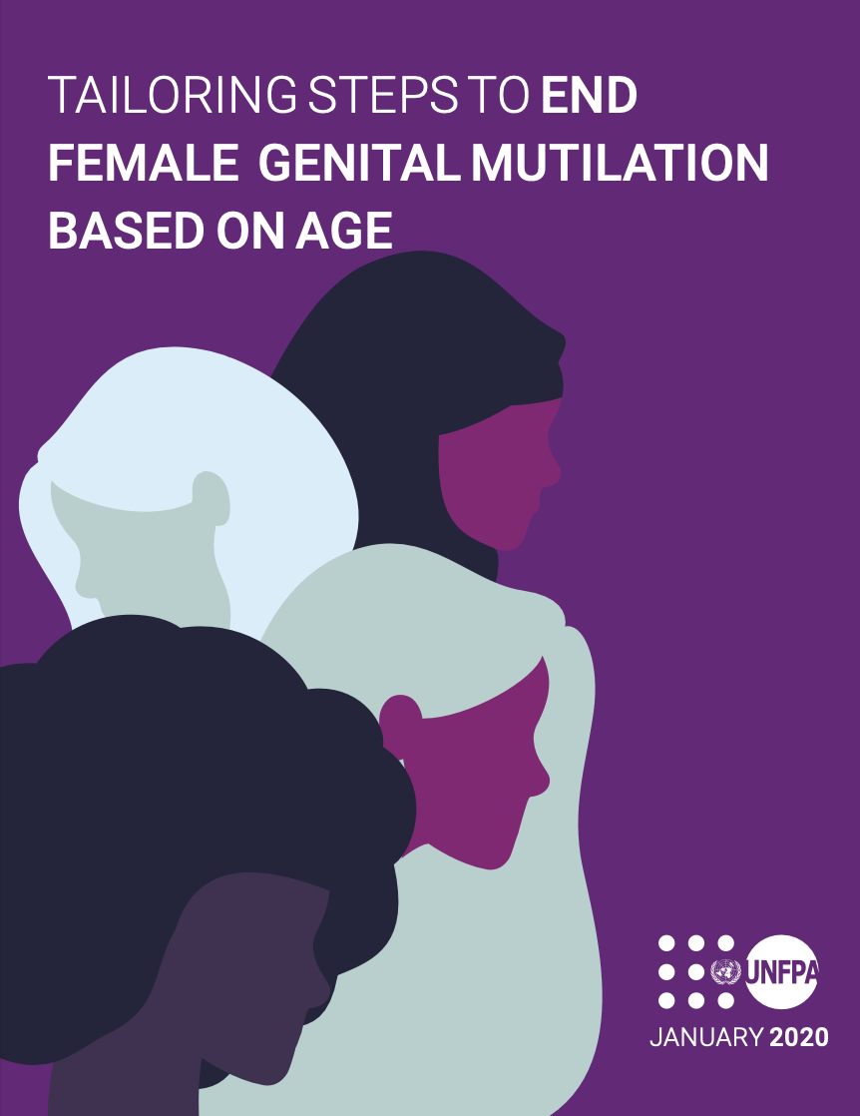
Sean Callaghan, 2024
Age of cutting
Addressing Limitation 6 – age of cutting
Indonesia
Malaysia
Somalia
Notes:
6. Failure to take age of cutting into account;

Slide 17
Sean Callaghan, 2024
Addressing Limitation 6 – age of cutting
Somalia
Indonesia
Malaysia
Notes:
Box plot to determine where the age of cutting concentrates

Slide 18
Analysis of the Results of the first two variables (population and prevalence)
Sean Callaghan, 2024
Sean Callaghan, 2022
Impact of addressing the first 6 limitations

Slide 19
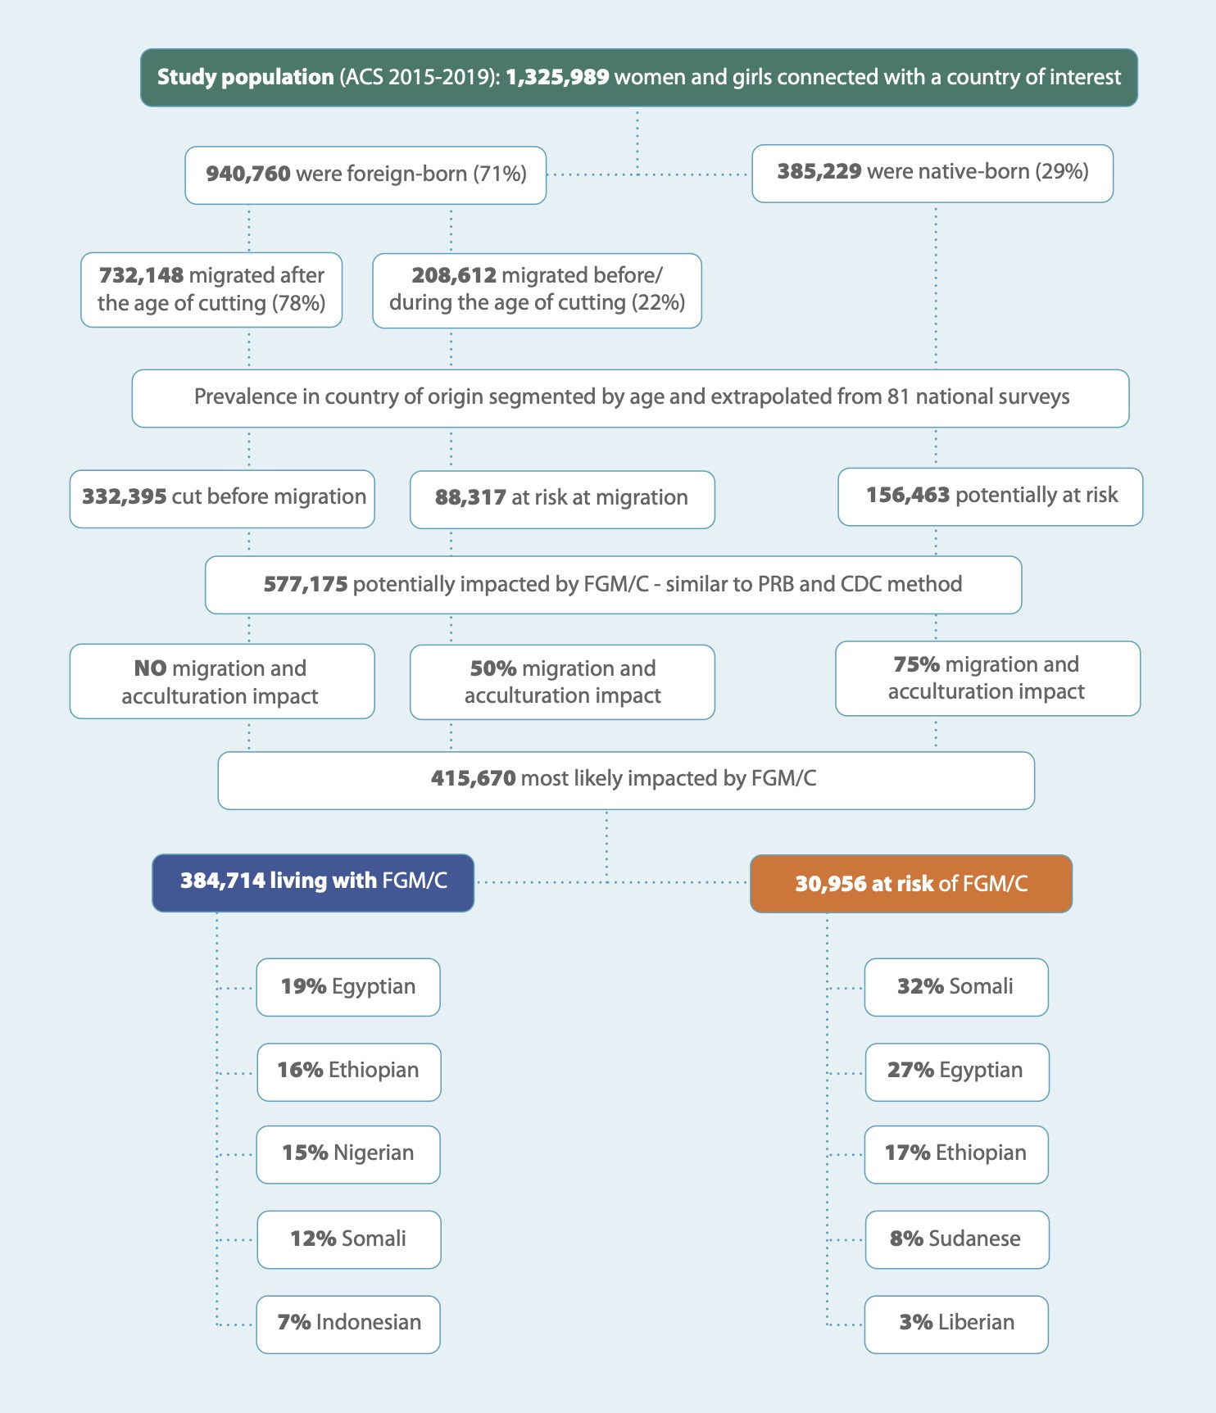
Sean Callaghan, 2024

Slide 20
Risk scenario based on mostly European studies of the impact of migration on risk
Sean Callaghan, 2024
Sean Callaghan, 2022
First attempt to address limitation 7 – impact of migration

Slide 21
Sean Callaghan, 2024

Slide 22
Sean Callaghan, 2024

Slide 23
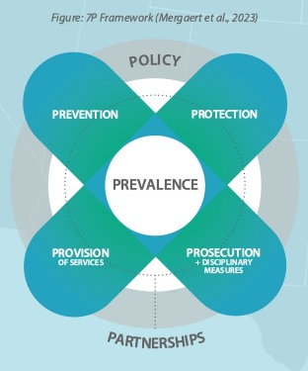
Sean Callaghan, 2024
1.3-mil with family connection
30,956 at risk
68,378 living with Type 3
52,318 crimes

Slide 24
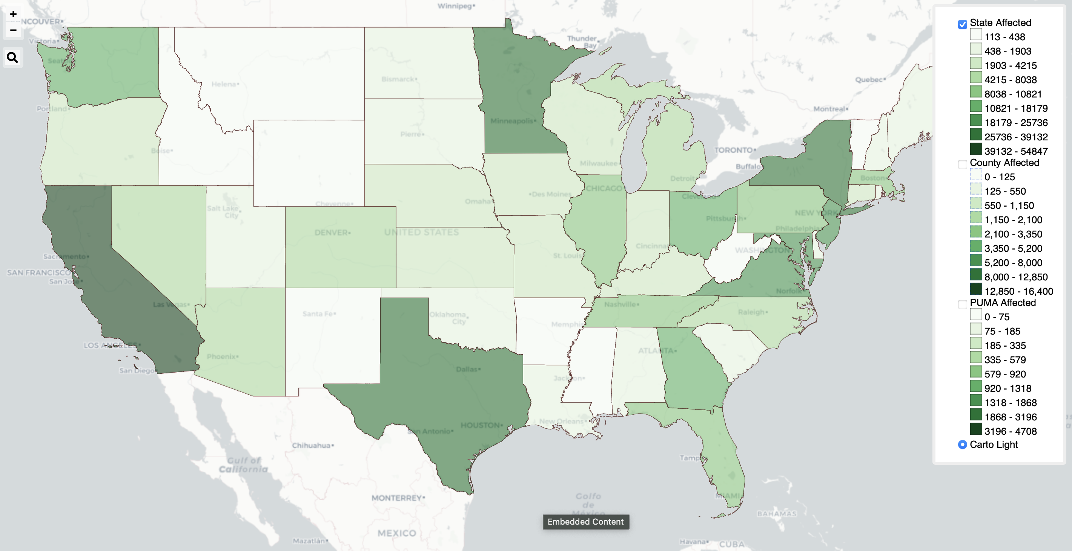
Sean Callaghan, 2024

Slide 25
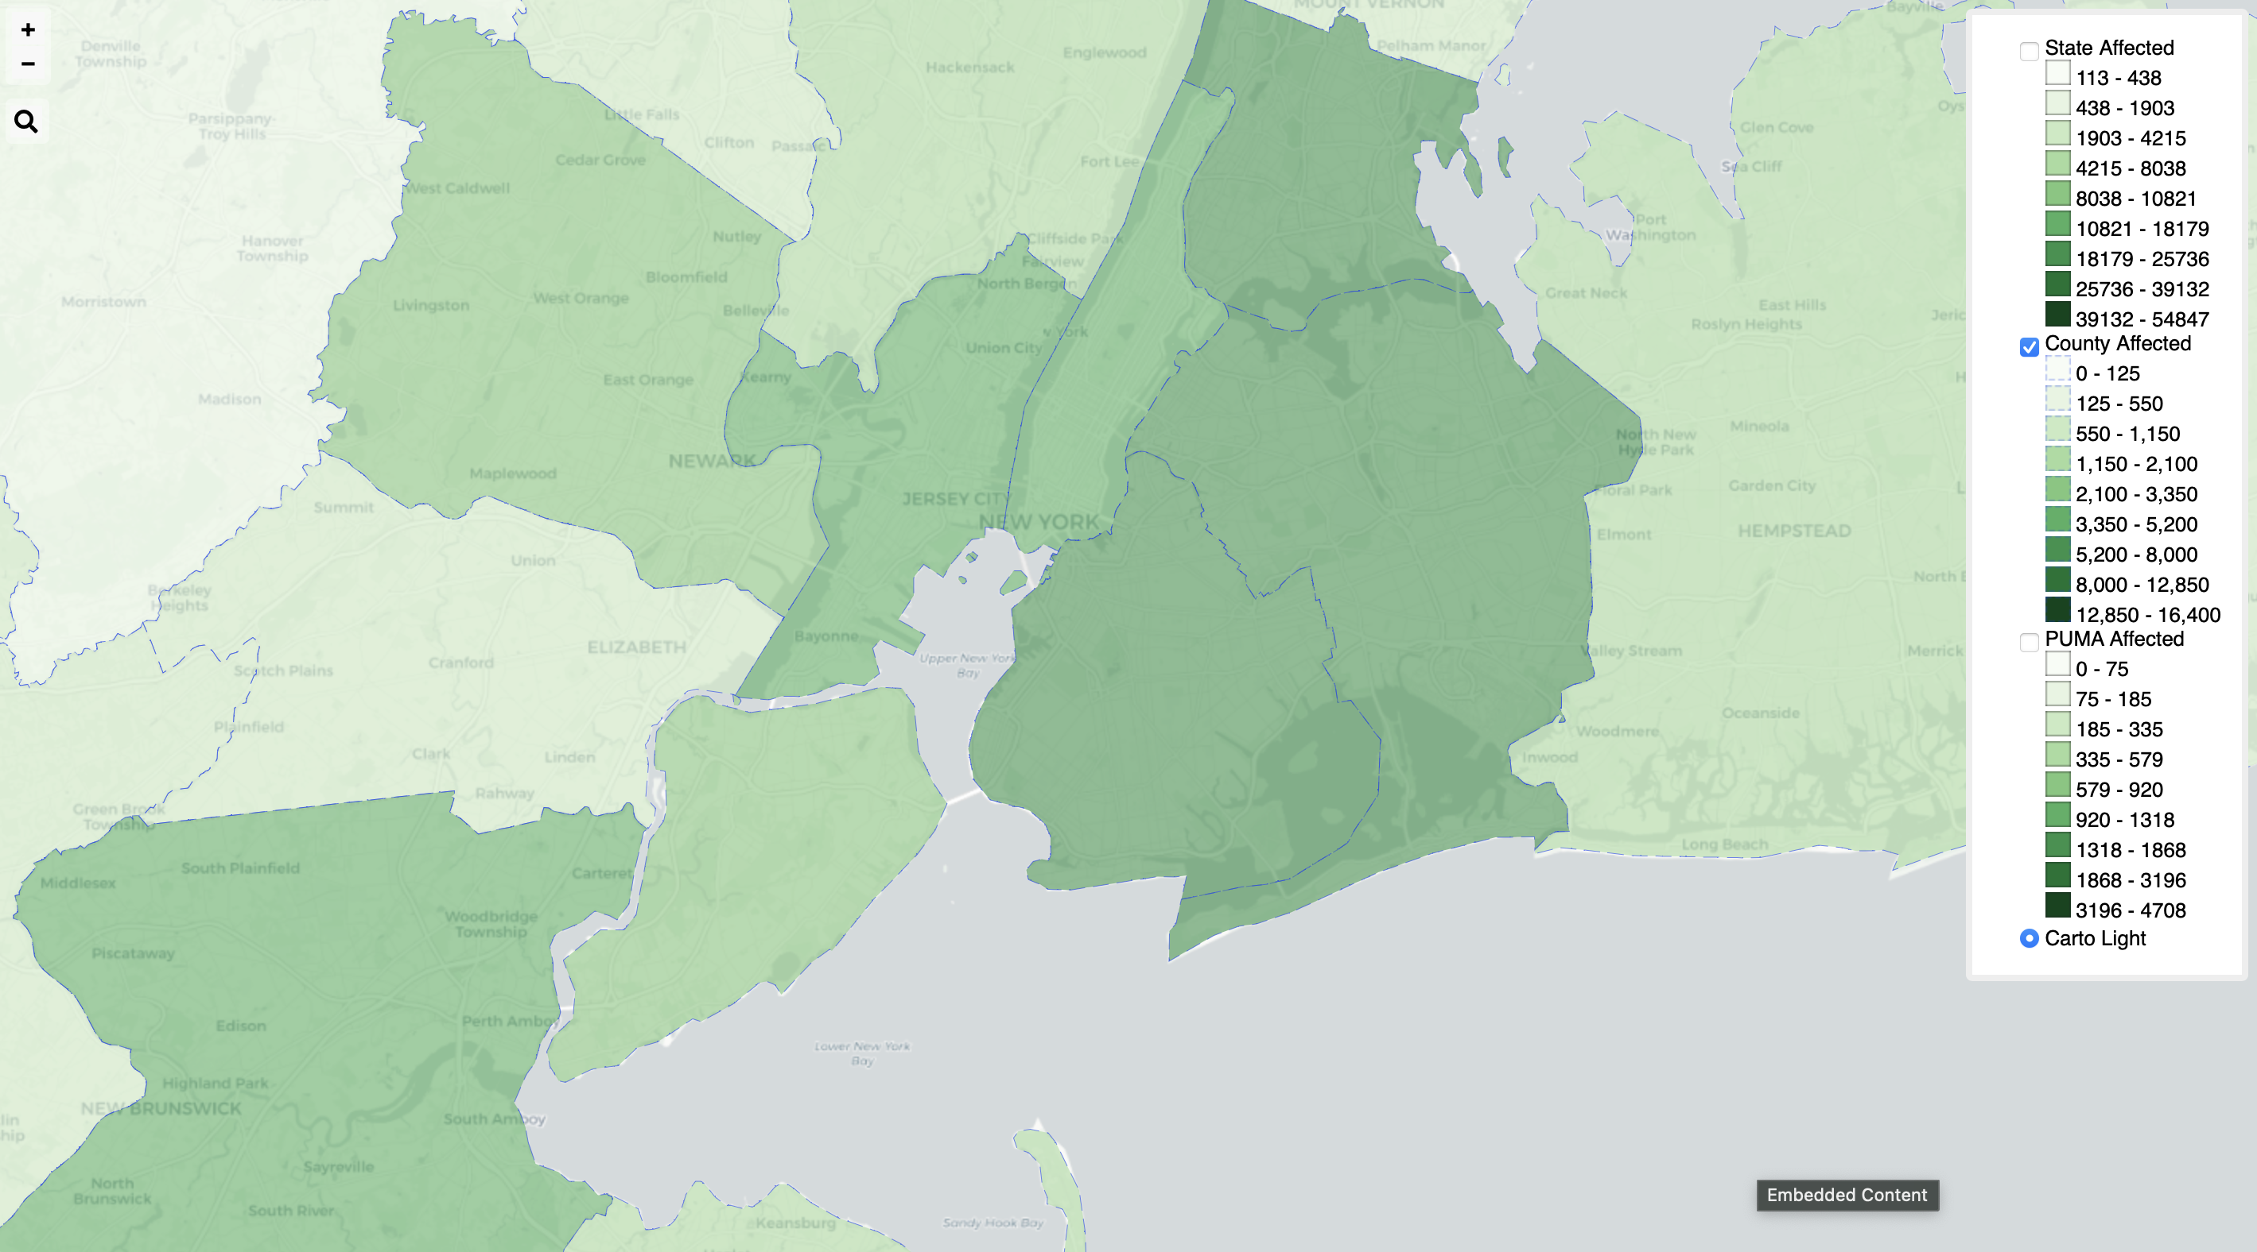
Sean Callaghan, 2024

Slide 26
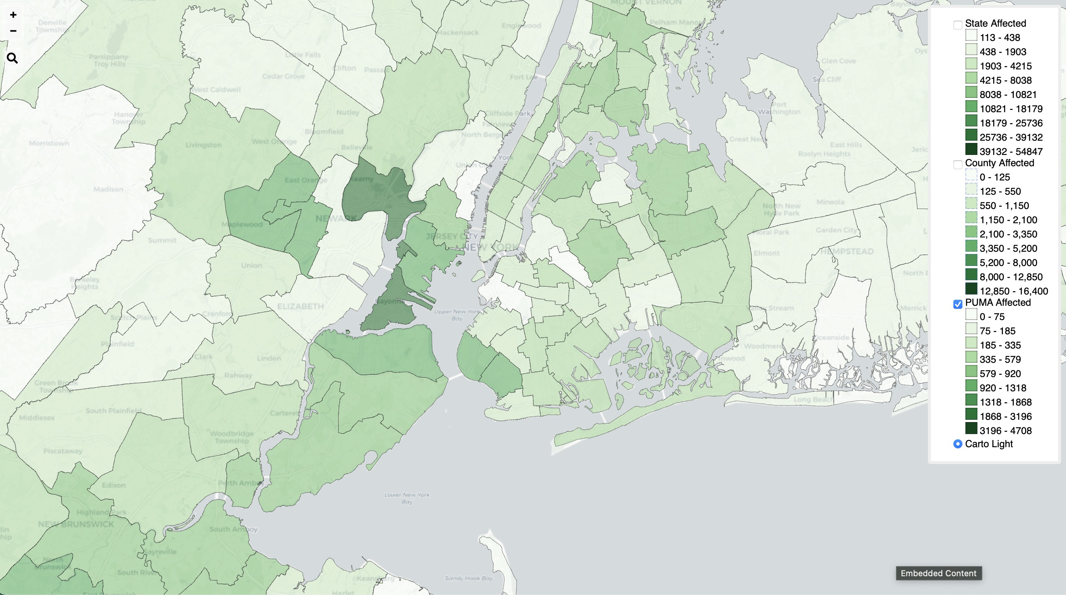
Sean Callaghan, 2024

Slide 27
Study 2: Impact of migration on risk
Sean Callaghan, 2024

Slide 28
Sean Callaghan, 2024
Sean Callaghan, 2022
 | No migration impact | Very high risk | High risk | Mid risk | Low risk | No risk
Cut before migration | 100% | 100% | 100% | 100% | 100% | 100%
Foreign born and migrated during or before typical age window of cutting | 100% | 100% | 75% | 50% | 25% | 0%
Native born | 100% | 75% | 50% | 25% | 0% | 0%
Addressing Limitation 7 – impact of migration

Slide 29
Sean Callaghan, 2024
Sean Callaghan, 2022
 | No migration impact | Very high risk | High risk | Mid risk | Low risk | No risk
Cut once resident in the U.S. | 146,875 | 125,756 | 89,037 | 52,318 | 15,599 | -
Native born at risk | 71,985 | 53,989 | 35,993 | 17,997 | - | -
Foreign born at risk | 25,920 | 25,920 | 19,441 | 12,960 | 6,480 | -
Total Impacted | 577,175 | 538,059 | 476,864 | 415,670 | 354,474 | 332,395

Slide 30
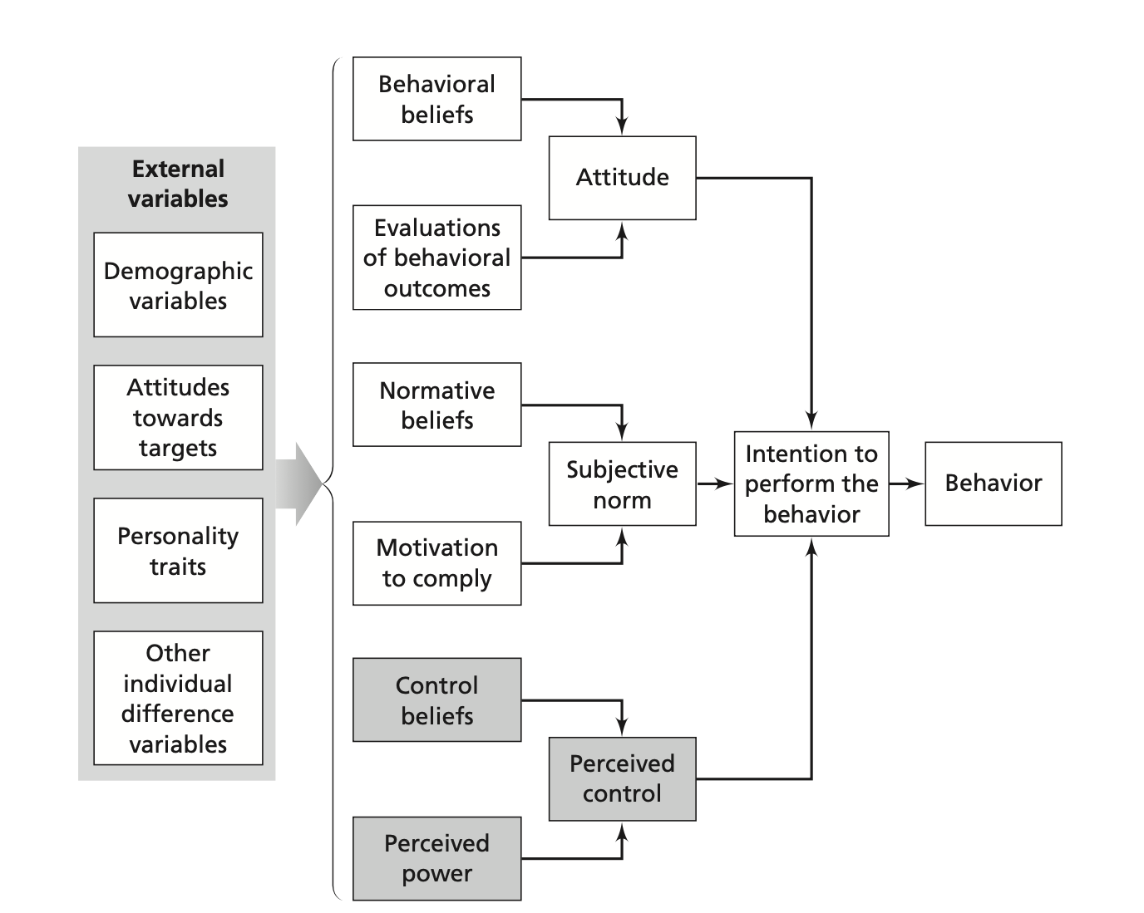
Sean Callaghan, 2024
Sean Callaghan, 2022
Surveys and key informant interviews based on the Theory of Planned Behavior

Slide 31
Sean Callaghan, 2024
Sean Callaghan, 2022
 | No migration impact | Very high risk | High risk | Mid risk | Low risk | No risk
Cut once resident in the U.S. | 146,875 | 125,756 | 89,037 | 52,318 | 15,599 | -
Native born at risk | 71,985 | 53,989 | 35,993 | 17,997 | - | -
Foreign born at risk | 25,920 | 25,920 | 19,441 | 12,960 | 6,480 | -
Total Impacted | 577,175 | 538,059 | 476,864 | 415,670 | 354,474 | 332,395

Slide 32
Deeper dive into Kansas
Sean Callaghan, 2024

Slide 33
Sean Callaghan, 2024
6,832
1,995
250
Study population
Living with
Girls at risk

Slide 34
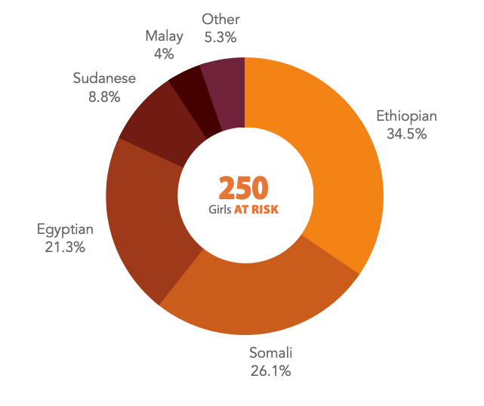
Sean Callaghan, 2024
Ethnic breakdown of girls most likely to be AT RISK of FGM/C in Kansas
NOTE: Nigerian and Indonesian girls are likely underrepresented in this data since
they are cut at a very young age, resulting in most girls being encoded as already living with FGM/C.

Slide 35
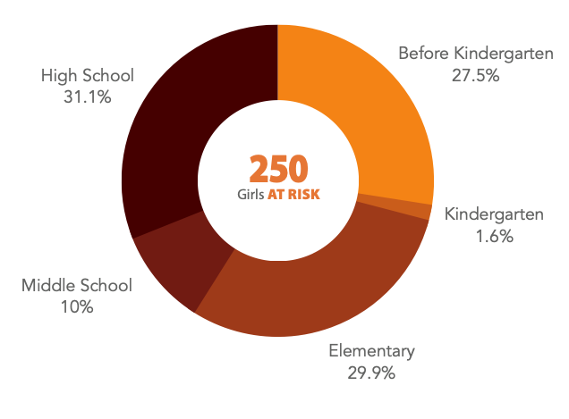
Sean Callaghan, 2024
Age distribution of girls most likely to be AT RISK of FGM/C in Kansas
NOTE: Nigerian and Indonesian girls are likely underrepresented in this data since
they are cut at a very young age, resulting in most girls being encoded as already living with FGM/C.

Slide 36
Sean Callaghan, 2024
Ethnic breakdown of women and girls most likely to be LIVING WITH FGM/C in Kansas
1,995
Living with

Slide 37
Sean Callaghan, 2024
Age distribution of women and girls most likely to be LIVING WITH FGM/C in Kansas

Slide 38
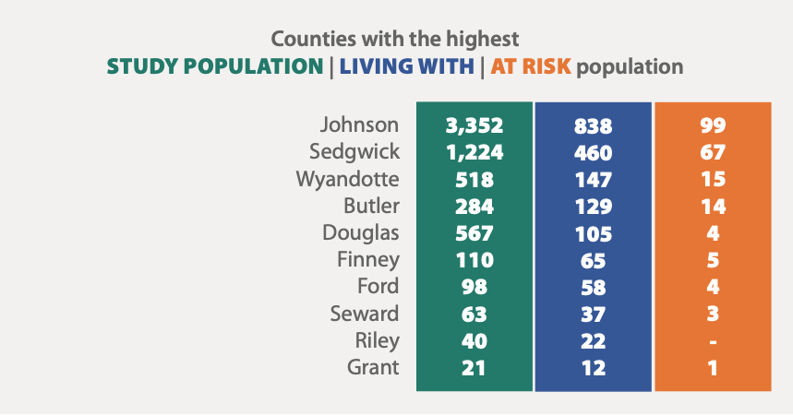
Sean Callaghan, 2024

Slide 39
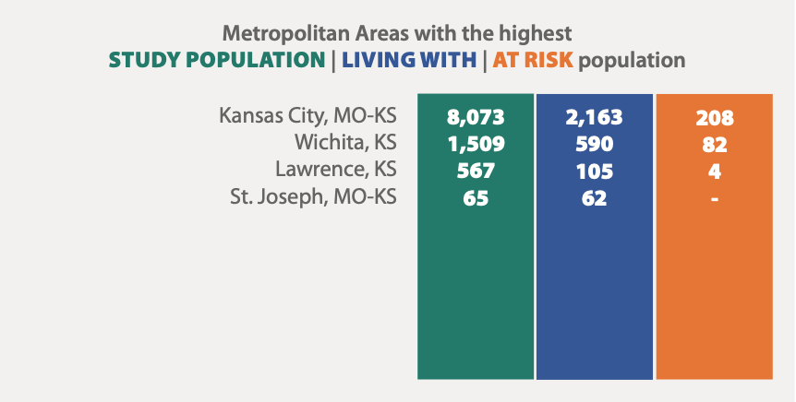
Sean Callaghan, 2024

Slide 40
Sean Callaghan, 2024
Most surrounding states have a greater number of impacted women and girls than Kansas

Slide 41
Sean Callaghan, 2024
Ethnic split of the impacted population by state
Colorado: Ethiopian (35%), Somali (17%), Eritrean (8%)
Kansas: Egyptian (24%), Ethiopian (20%), Somali (12%)
Missouri: Somali (22%), Nigerian (14%), Ethiopian (14%)
Nebraska: Somali (47%), Sudanese (31%), Egyptian (8%)
Oklahoma: Nigerian (22%), Ethiopian (17%), Malay (14%)

